Slide 1

Data Analytics training:
CAx Analysis
Notes:
A quick reminder of the recommendations

Slide 2
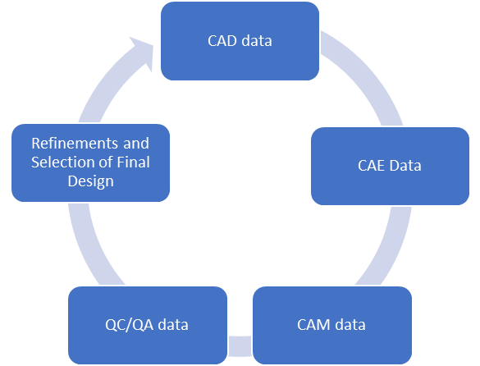

Use of CAx models for structuring AM build information
CAx models contain inherent useful information for the selection of process parameters for an AM build.
CAD data: Mesh Information
CAE data: Simulation / Analysis information
CAM Data: Manufacturing / Process data
QC/QA data: Testing and measurement data
By structuring CAx information and building predictive process models, the designer/engineer may reduce the time required for refinement of part/assembly design.
AM – CAx data
Notes:
A quick reminder of the recommendations

Slide 3
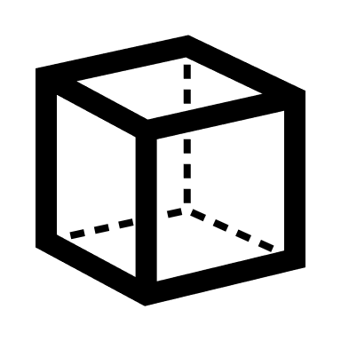





Typical Additive Manufacturing (AM) Workflow
Design and build 3D-CAD model.
Engineering simulation and analysis
Slicing and toolpath generation
Build component/Part fabrication
Post-Processing
Quality assessment and testing
DESIGN
ENGINEERING
OPERATION
SERVICE/FEEDBACK
Notes:
A quick reminder of the recommendations

Slide 4
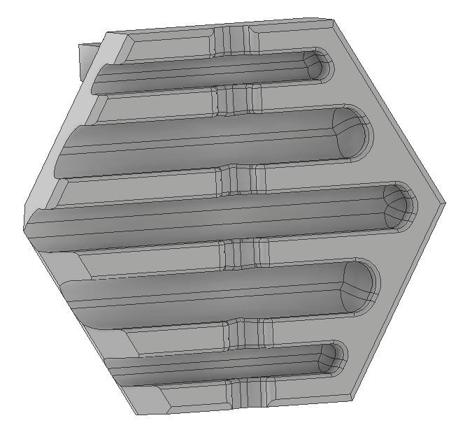
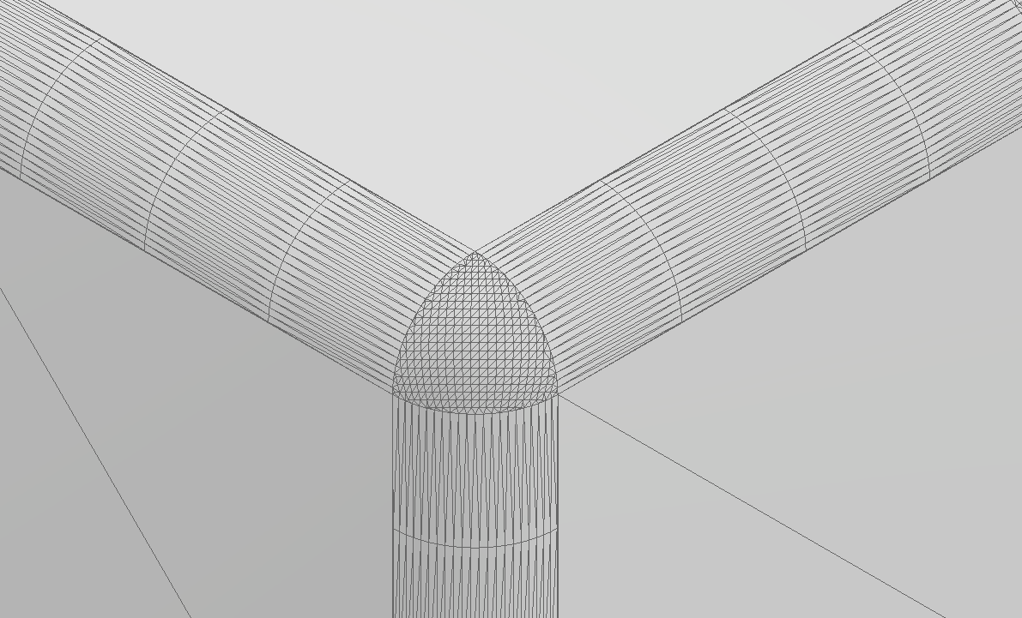
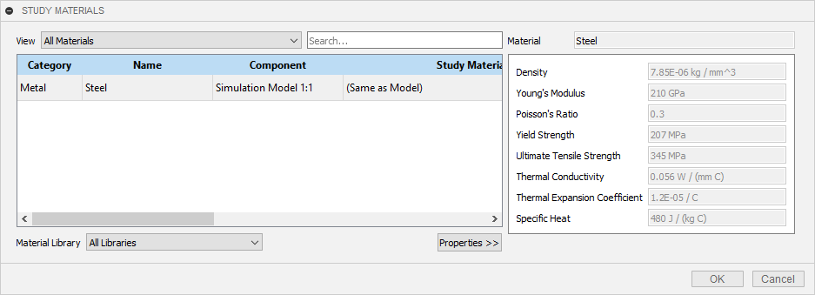
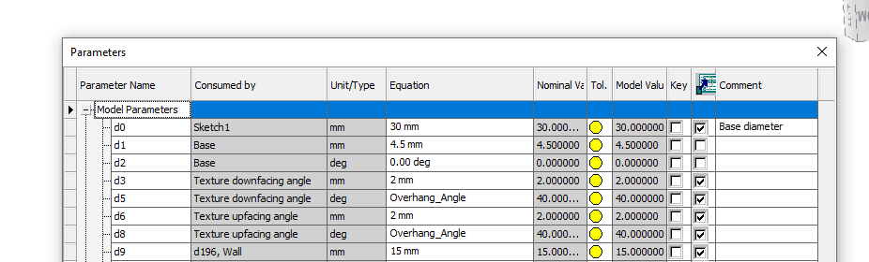
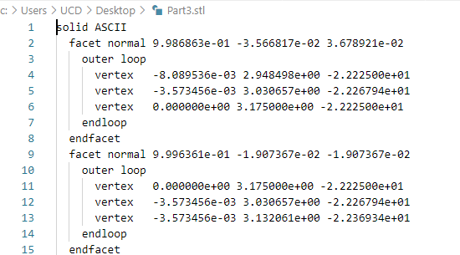
Information at different stages of the AM workflow - Design and build 3D-CAD model data
Design and build 3D-CAD model data.
Parametric design information
Mesh data
Material information
Notes:
A quick reminder of the recommendations

Slide 5
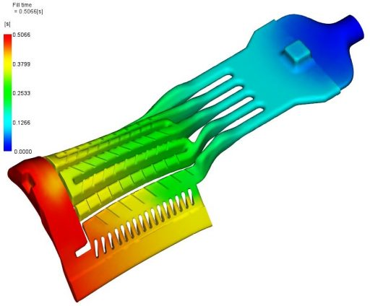

Information at different stages of the AM workflow - Engineering simulation and analysis data
Structural Analysis
Engineering simulation and analysis data
Vibrational Analysis
Thermal Analysis
Engineering simulations based on the methodologies like Finite Element Analysis (FEA), would generate data points by solving differential equations for each point in a mesh designed for the analysis.
Thermal analysis using FEA being carried out on a turbine blade is shown as an example.
Notes:
Thermal Analysis –
[1] Core competence gets additive – Aerospace Manufacturing, (n.d.). https://www.aero-mag.com/gas-turbine-blades-additive-manufacturing/ (accessed February 10, 2021).

Slide 6
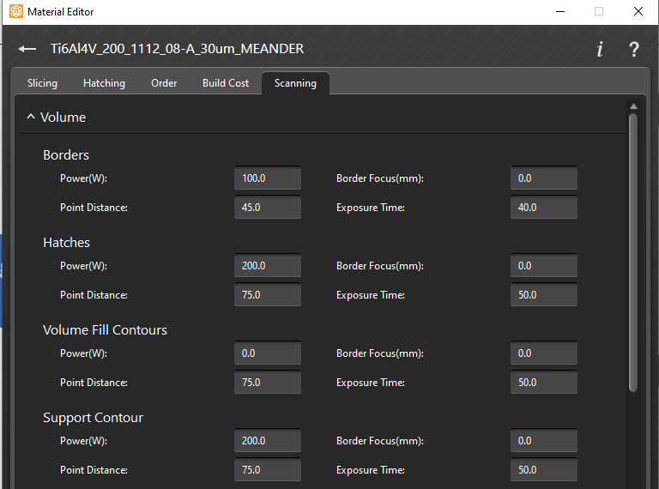
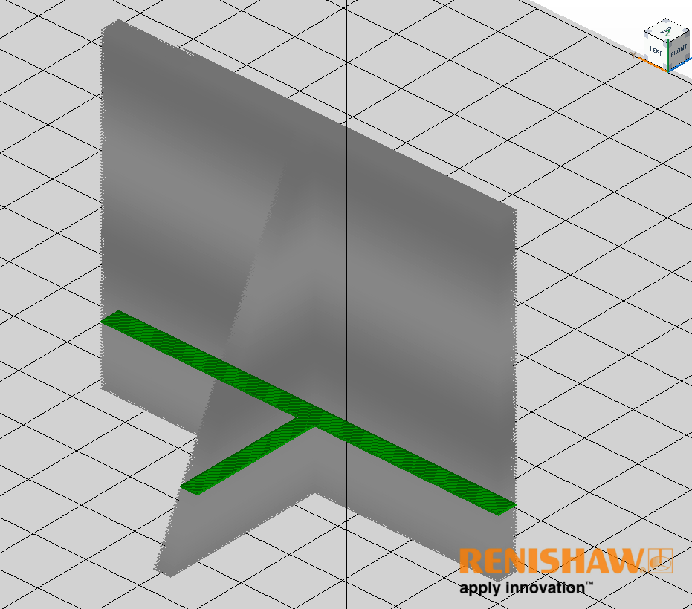
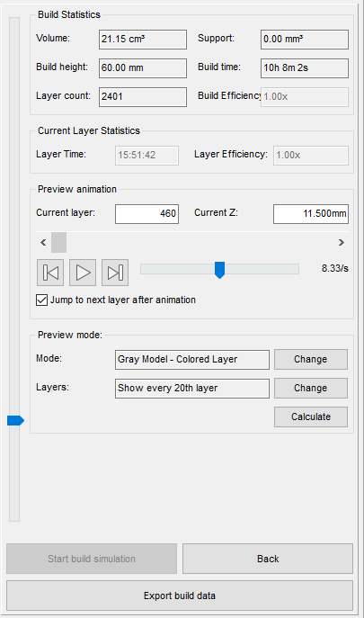
Information at different stages of the AM workflow - Slicing and toolpath generation data
Slicing and toolpath generation data
Selection of process parameters
Generation and visualization of tool path
Notes:
A quick reminder of the recommendations

Slide 7
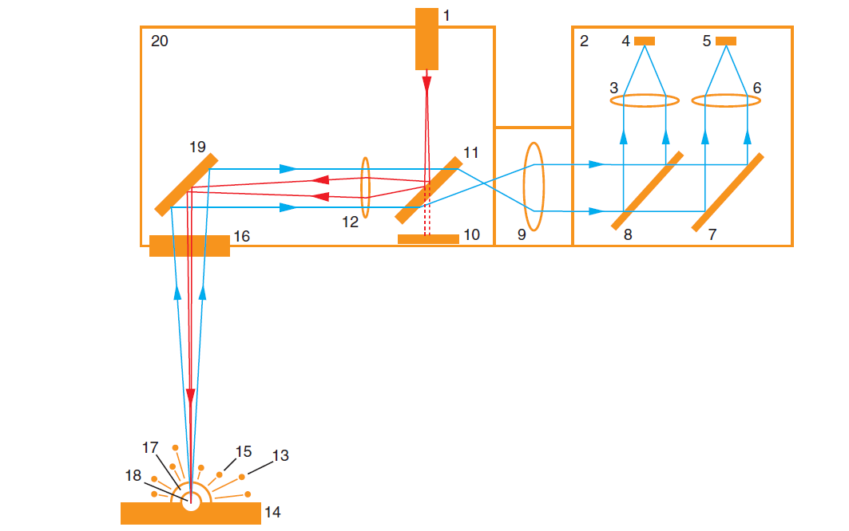
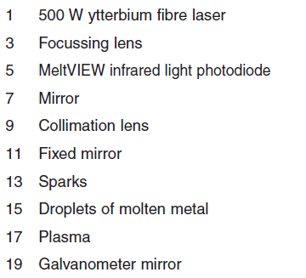
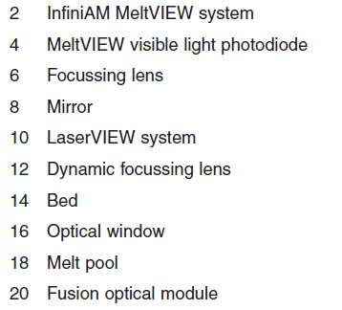
Information at different stages of the AM workflow -Build component/Part fabrication data
Build component/Part fabrication data
AM Machine sensor information
The figure represents the anatomy of the Renishaw RenAM 500 build chamber and sensor layout. RenAM deploys a powder bed fusion (PBF) technology.
Meltview Photodiodes (4,5) captures in-situ build emissions in visible and infra-red spectrum yielding heatmaps.
Laserview System (10) measures the laser intensity during AM build.

Slide 8
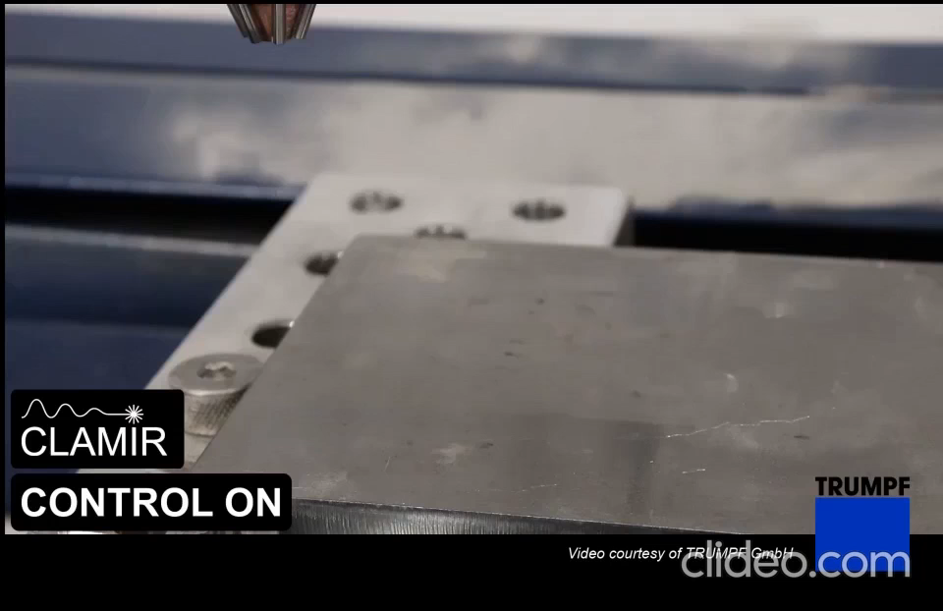
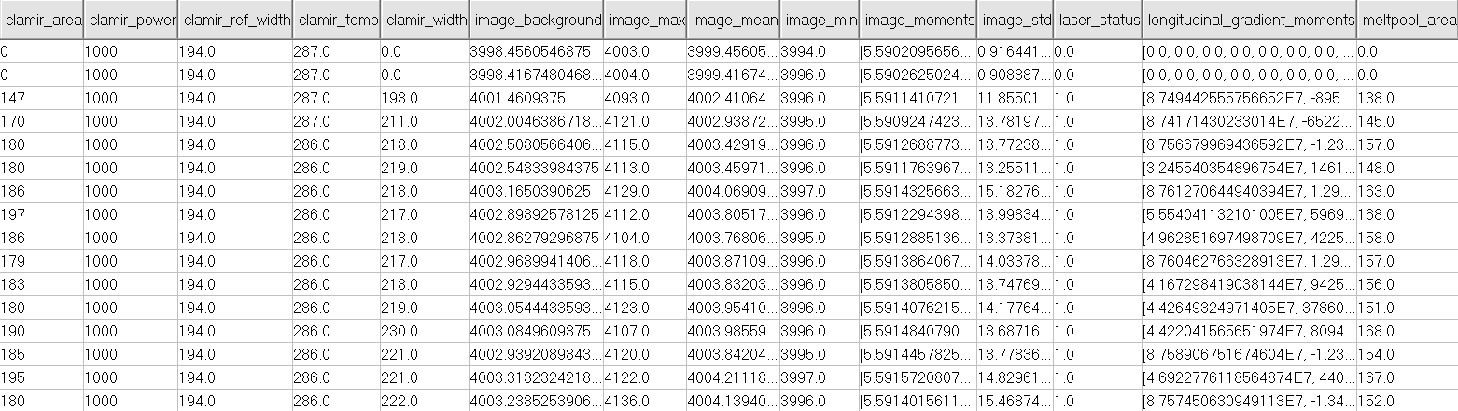
Information at different stages of the AM workflow - Build component/Part fabrication data
Build component/Part fabrication data
In-situ process data from AM build
Direct Energy Deposition
The figure represents the in-situ process measurements during an AM build utilizing Direct Energy Deposition (DED) technology.
Notes:
A quick reminder of the recommendations

Slide 9
Information at different stages of the AM workflow - Post-Processing data
Support material removal
Excess material removal
Post-Processing data
Surface finish
Heat treatment
Notes:
A quick reminder of the recommendations

Slide 10
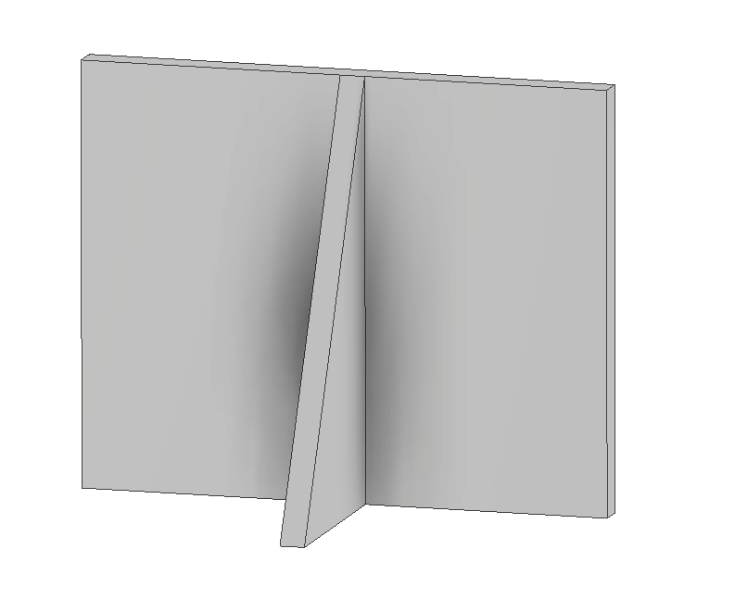
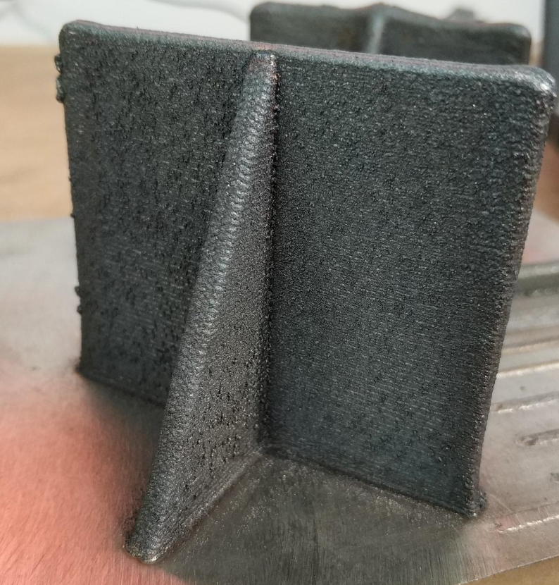
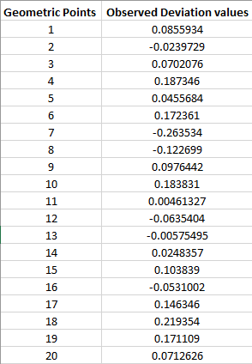
Information at different stages of the AM workflow - Quality assessment and testing data
Quality assessment and testing data
Geometric Tolerance levels
vs
3D-CAD model
Physical model
Using Co-ordinate measurement machine, it is possible to measure geometric deviation at specific points of interest on the physical design and compare with the corresponding points on the CAD model.
Notes:
A quick reminder of the recommendations

Slide 11
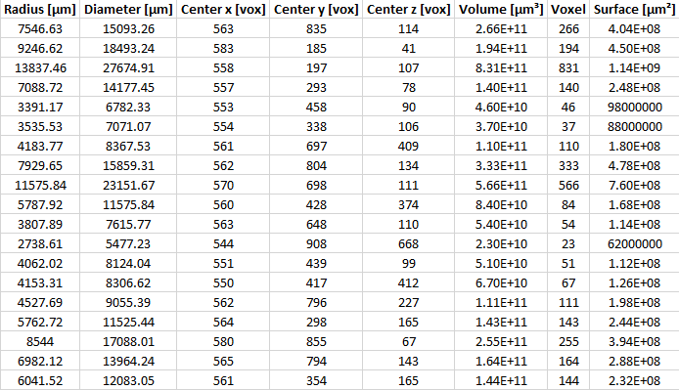
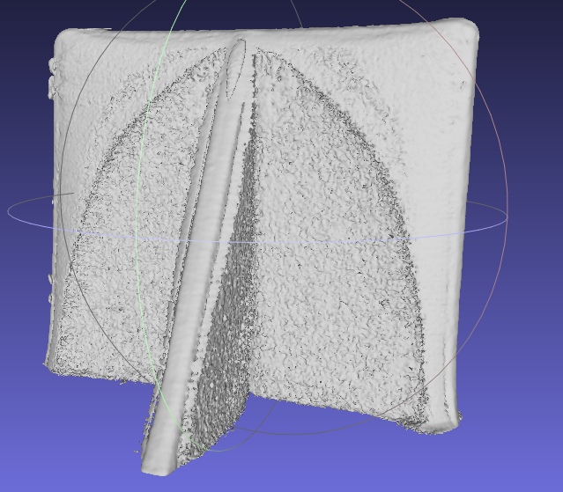
Information at different stages of the AM workflow
Quality assessment and testing data
Non – destructive testing for structural analysis
vs
3D-CAD model
Reconstructed CT scan
Using CT-scan, it is possible to evaluate AM produced parts to be assessed for porosity within the part. This would help to find the location and size of a pore.
Notes:
A quick reminder of the recommendations

Slide 12
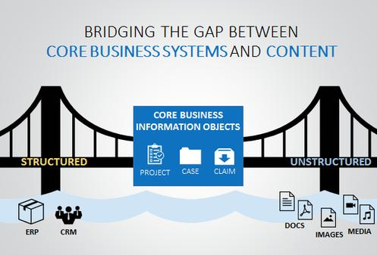
Importance of Data Analytics in AM - CAx
Existing analytics deals with
Data in isolated sources
Unstructured data & structured data in a PLM
Lack of general framework applied
Availability of APIs for data extraction
Data integration across different phases.
Lack of unified software packages
Design
Generation of toolpath
Evaluation and analysis
Notes:
[1] Unstructured Big Data Is a Big Manufacturing Challenge | designnews.com, (n.d.). https://www.designnews.com/automation-motion-control/unstructured-big-data-big-manufacturing-challenge (accessed February 12, 2021).
Existing analytics approaches on unstructured data in a PLM focussing on isolated data sources from a single product life cycle phase, do not make use of structured data for holistic analytics and are typically cost-intensive and case-based, without a general framework.

Slide 13

Data Analytics in AM Cax - Algorithm
CAD Model.
CAE Simulation and Analysis
CAM Tool / Slicing Engine
In-Situ data from AM machine
Post-Processing data
QA/QC & Testing.
CT SCAN data
NDT data
Datasets
Unified Data Model
Data Preparation and cleaning
Data Visualization
Machine learning techniques
Artificial Intelligence algorithms
Unified data model using AM Schema
Example: AM_schema_R2019a
Notes:
Decker, N., & Huang, Q. (2020). Intelligent accuracy control service system for small-scale additive manufacturing. Manufacturing Letters, 26, 48-52.

Slide 14
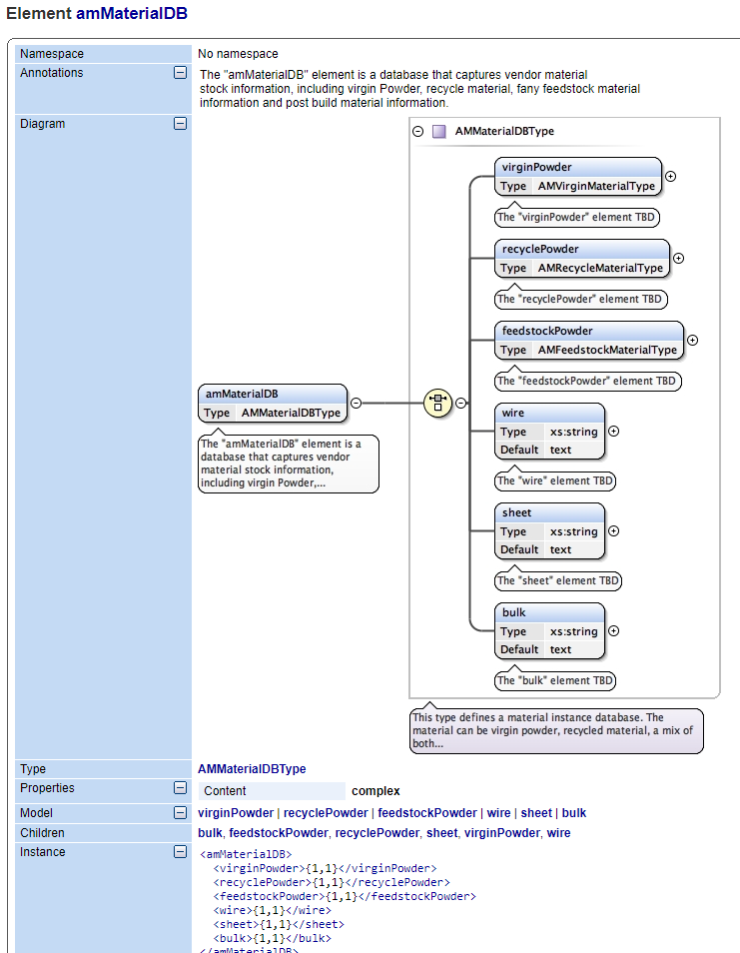
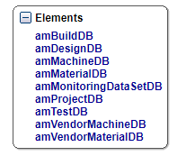
Data Analytics in AM – CAx- Structuring the data using an AM Schema
A data schema is a database with a data structure, described and supported by the database management system.
Here, the data is organized in different classes according the nature and volume of data.

Slide 15
Data Analytics in AM – CAx – File formats
Main data storage formats for scientific research are HDF and netCDF
HDF stands for Hierarchical Data Format. It is a file format designed to store and organize large amounts of data of different datatypes. HDF is supported by many commercial and non-commercial software platforms and programming languages.
NetCDF stands for Network Common Data Form. It is a self-describing, machine-independent data format that support the creation, access, and sharing of array-oriented scientific data.
Notes:
A quick reminder of the recommendations

Slide 16
Impact of Data Analytics in AM - CAx
Data Preparation and cleaning
Data Visualization
Machine learning techniques
Artificial Intelligence algorithms
Advantages
Disadvantages
Improved process intelligence
Significant time and resources
Cost reduction
Improved decision making
High error susceptibility
Achieve higher levels of customization
Automation capabilities
Proper interpretation of results
Improved innovation
Predictive modelling capability
Data acquisition across domains
Notes:
A quick reminder of the recommendations

Slide 17
Data Analytics- Challenges
Variation in Print settings/parameters
Variation in Material used
Variation AM methods used
Shape heterogeneity
Different printer manufacturers
Different printer models
Slicing software used
Highly customized items require customized compensation
Solution:- A distributed system architecture
Notes:
Decker, N., & Huang, Q. (2020). Intelligent accuracy control service system for small-scale additive manufacturing. Manufacturing Letters, 26, 48-52.

Slide 18
AM – Distributed system for Geometric accuracy Prediction and Control
Data-driven model for an AM requires advanced knowledge in statistical modeling or machine learning
A centralized cloud system could overcome the knowledge gap and resource constraints
No-proprietary files- Accuracy and equipment data
No-proprietary files- Accuracy and equipment data
Cloud base application for exchange of model data
No-proprietary files-
No-proprietary files-
AM software for Prediction and Control
AM software for Prediction and Control
Client 2
Prediction
Prediction
Client 1
Trained models
Accuracy prediction and compensation
Accuracy prediction and compensation
Software tools
Software tools
Expert 1
Expert 2
3rd party service 1
3rd party service 2
Notes:
A quick reminder of the recommendations

Slide 19
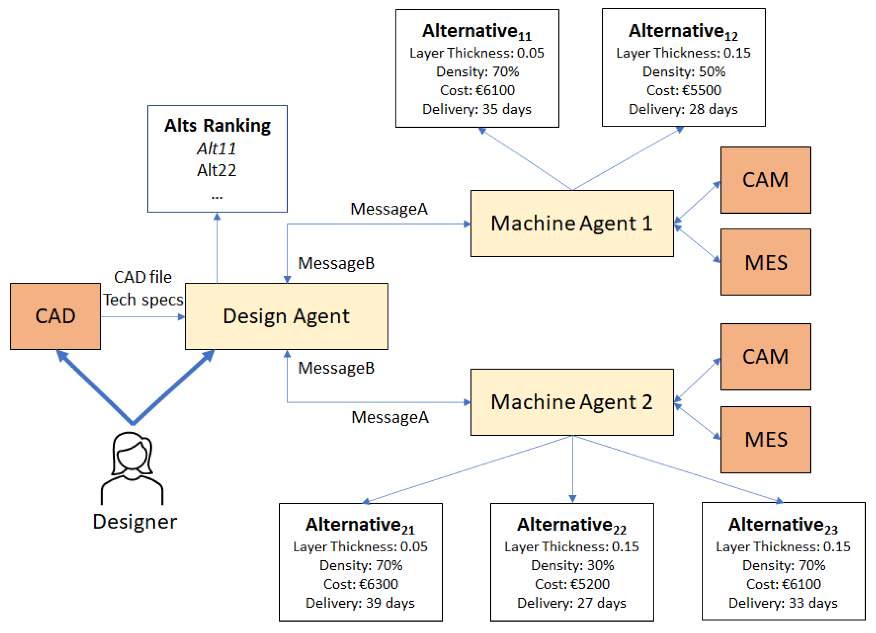
Case Study - Agent Based decision support
Estimation of process cost, time, and quality for additive manufacturing operations for making informed product design and development decisions.
Agent-based decision support platform, capable of proposing alternative additive manufacturing resources and process configurations to design engineers
Different CAx systems are utilised and interfaced for automating the information exchange as well as for accelerating the overall product development process.
Notes:
Decker, N., & Huang, Q. (2020). Intelligent accuracy control service system for small-scale additive manufacturing. Manufacturing Letters, 26, 48-52.

Slide 20
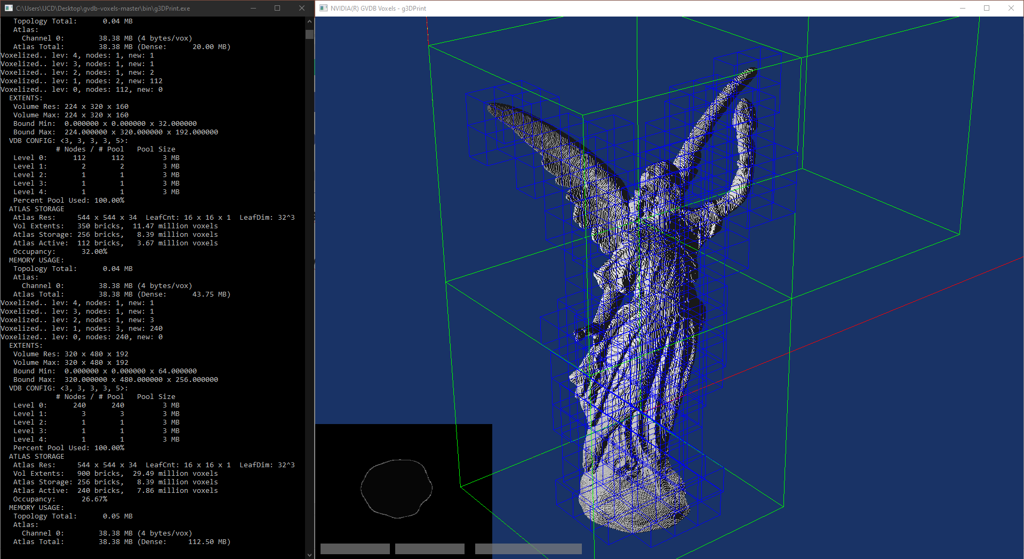
Case Study - Framework for correlating AM-printed part properties with CAx model features and process configuration inputs using nvidia GVDB voxels.
Use of voxelization techniques on CAx models throughout the product development phase.
Combining discretised information from CAD / CAM files and process and QC/QA data, may lead to the development of accurate predictive process models.
Notes:
A quick reminder of the recommendations

Slide 21
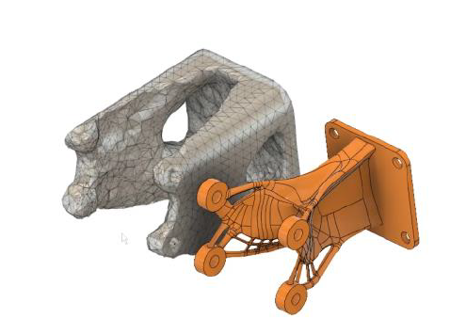
Case Study – Shape optimized and Generative designs
Shape optimized design
Using Fusion 360, it is possible to iterate design based on Computer - aided - engineering (CAE) data.
Shape optimization is looking to begin the simulation using a body shape that you create. It will use this shape as the bounding box for the solution.
The generative design result considers the stress distribution. Material is removed from low stress areas and added to high stress areas.
These design strategies create complex geometric shapes which is more suitable to be manufacturing using AM.
Generative Design
Notes:
[1] Autodesk, Lesson : Shape Optimization Vs . Generative Design, (n.d.) 1–2.

Slide 22
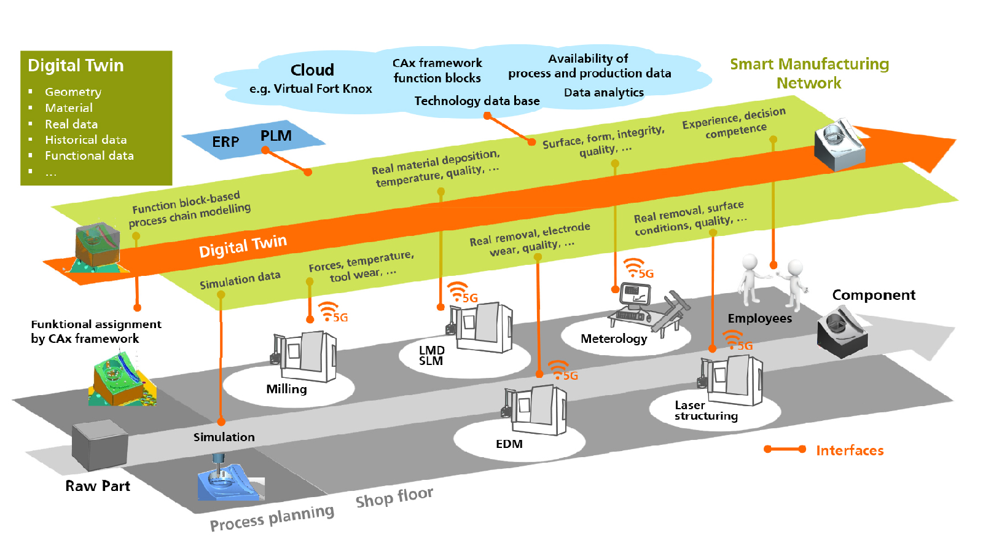
Case Study – Smart Manufacturing with Digital twin
With the introduction of Industry 4.0, Manufacturers have turned towards digitalization of services to improve efficiency.
Networked machines have changed the industrial landscape providing manufacturers more options with fault detection, machine monitoring and manufacturing flexibility.
Notes:
[1] Fraunhofer Create Development Community for Industry 4.0 Applications and Technologies – Metrology and Quality News - Online Magazine, (n.d.). https://metrology.news/fraunhofer-create-development-community-for-industry-4-0-applications-and-technologies/ (accessed February 10, 2021).

Slide 23
Thank you
Notes:
A quick reminder of the recommendations

